Slide 1
Tesla Stock Price Prediction Using Machine Learning
Submitted To: Bhargavi MS
Associate Prof,
CSE BIT, Bangalore.
Submitted By: Spoorthy UK
1BI22SCS06

Slide 2
Abstract
The abstract of this project delves into the captivating journey of leveraging machine learning to forecast the future movement of Tesla's stock prices.
In this pursuit, historical stock price data of Tesla is meticulously analyzed and transformed into a predictive tool.
The project commences with comprehensive data preprocessing, including feature engineering that involves the creation of innovative variables to capture underlying trends.
The data is then visually explored, unraveling insights through visualizations that shed light on the intricate relationships within the dataset.
The crux of the project lies in the application of machine learning algorithms to predict whether Tesla's stock price will ascend or descend.

Slide 3
A trio of models is introduced: Logistic Regression, Support Vector Machines with polynomial kernels, and the RandomForestClassifier. These models are carefully trained and rigorously evaluated using metrics like the Area Under the ROC Curve (AUC) and confusion matrices.
The outcome of the project unveils more than just predictive capabilities. It provides a panoramic understanding of how data science and machine learning can be harnessed to uncover hidden signals within financial data.
Through the interplay of data analysis, feature engineering, and model evaluation, the project bridges the gap between technical innovation and real-world financial decision-making.

Slide 4
Introduction
In the fast-paced world of finance, predicting stock prices is like solving a complex puzzle. Traders and experts are always seeking new ways to make smarter decisions. Today, we're diving into an exciting journey: using machine learning to forecast how Tesla's stock prices might change.
Tesla's stock price fluctuations can be a source of great interest and debate among investors, traders, and financial professionals.
With our data primed and prepared, we will introduce a trio of powerful machine learning models that are well-suited for stock price prediction.
These models, including Logistic Regression, Support Vector Machines (SVM) with polynomial kernels, and the RandomForestClassifier, serve as our virtual crystal balls in deciphering the intricate dance of stock prices.
In the context of stock price prediction or any other binary classification task, AUC measures how well a model can distinguish between two classes (e.g., stock price increase and stock price decrease)

Slide 5
Problem Statement
The problem at hand is to harness the power of data science and machine learning to predict whether Tesla's stock prices will increase or decrease on the next trading day.

Slide 6
Objectives
Data Analysis and Exploration
Feature Engineering
Model Selection and Training
Model Evaluation and Performance
Model Comparison and Selection
Insight Generation
Real-world Application
Future Enhancement and Exploration

Slide 7
Pre-processing
Preprocessing is a crucial step in preparing the data for analysis and modeling. It includes the following steps:
Data Loading
Data Cleaning
Date Conversion
Feature Engineering
Data Visualization
Data Splitting

Slide 8
Dataset description with snapshot of dataset
The dataset contains historical daily stock price data for Tesla, an innovative electric vehicle and clean energy company, spanning over a period of time. The dataset includes various features related to Tesla's stock performance, such as opening and closing prices, daily high and low prices, trading volume, and date-related information.
Features in dataset:
Date: The date of the trading day.
Open: The opening price of Tesla's stock on that trading day.
High: The highest price reached by Tesla's stock on that trading day.
Low: The lowest price reached by Tesla's stock on that trading day.
Close: The closing price of Tesla's stock on that trading day.
6. Volume: The trading volume (number of shares traded) of Tesla's stock on that trading day.
7. Day: The day component extracted from the 'Date' column.

Slide 9
Derived Features (Feature Engineering):
Month: The month component extracted from the 'Date' column.
Year: The year component extracted from the 'Date' column.
is_quarter_end: A binary flag indicating whether the trading day is at the end of a quarter

Slide 10
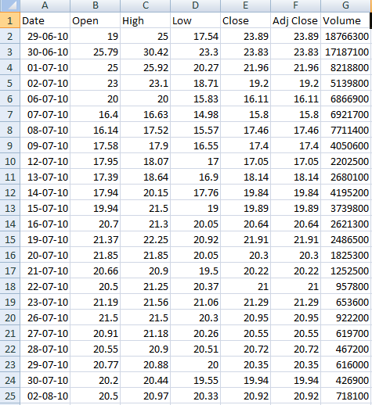

Slide 11
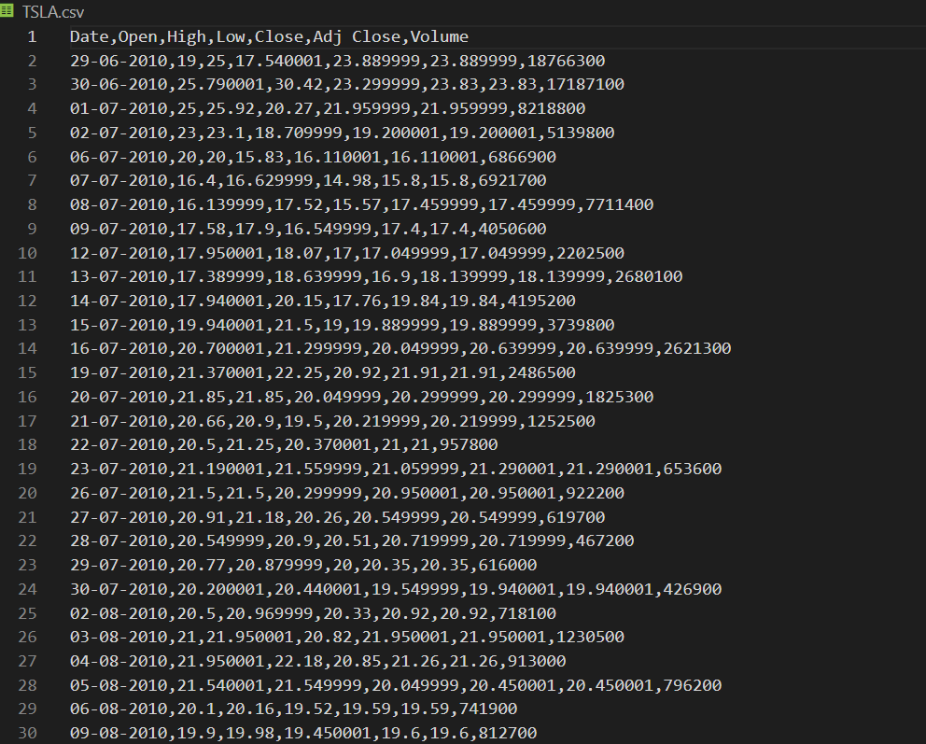

Slide 12
Tools to be used
Python: A versatile and widely-used programming language for data analysis and machine learning.
Pandas: A powerful library for data manipulation and analysis, essential for loading, preprocessing, and exploring your dataset.
NumPy: A fundamental library for numerical computations, often used in conjunction with Pandas.
Matplotlib and Seaborn: Visualization libraries for creating various types of plots and graphs to analyze data patterns and trends.
Scikit-Learn: A comprehensive library for machine learning, providing tools for data preprocessing, model selection, training, and evaluation.

Slide 13
Confusion Matrix Plotting (Scikit-Learn): Useful for visualizing the performance of your models' predictions.
DateTime Library: Python's built-in library for handling dates and times, important for date-based feature engineering.

Slide 14
Algorithms used
Logistic Regression:
Logistic Regression is a widely used binary classification algorithm.
It models the probability that a given input belongs to a particular class.
In your project, you're using it to predict whether the stock price will increase or decrease (binary classification).
Support Vector Machines (SVM) with Polynomial Kernels:
Support Vector Machines are powerful classification algorithms.
You're using the SVM algorithm with polynomial kernels, which can capture complex relationships in the data.
SVM aims to find the hyperplane that best separates the classes.

Slide 15
RandomForestClassifier:
RandomForestClassifier is an ensemble algorithm based on decision trees.
It builds multiple decision trees and combines their predictions to improve accuracy and robustness.
RandomForestClassifier is capable of capturing non-linear relationships in the data.

Slide 16
Methodology
Problem Definition and Objective:
Clearly define the problem: predicting Tesla's stock price movement (increase/decrease).
Specify the project's objectives, such as developing accurate predictive models.
Data Acquisition:
Obtain historical daily stock price data for Tesla from a reliable source.
Load the data into a suitable data structure (e.g., pandas DataFrame).
Data Preprocessing:
Check for and handle missing values, if any.
Convert the 'Date' column to datetime format for time-based analysis.
Engineer new features like 'day', 'month', 'year', and 'is_quarter_end'.
Remove unnecessary columns like 'Adj Close'.
Data Exploration and Visualization:
Create visualizations (line plots, histograms, box plots) to understand data distributions and patterns.
Analyze correlations between features using a heatmap.

Slide 17
Feature Engineering:
Generate additional features like 'open-close' and 'low-high' price differentials.
Create a target variable ('target') indicating stock price increase (1) or decrease (0).
Data Splitting:
Split the dataset into training and validation sets for model development and evaluation.
Model Selection and Training:
Choose algorithms (Logistic Regression, SVM with polynomial kernels, RandomForestClassifier).
Model Evaluation and Comparison:
Evaluate models using metrics like AUC (Area Under the ROC Curve) and confusion matrices.
Compare performance to select the best-performing model.

Slide 18
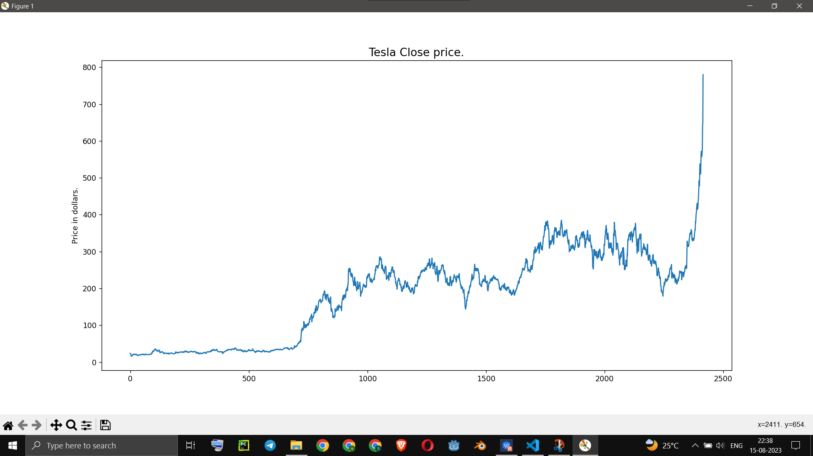
Results
fig:1

Slide 19
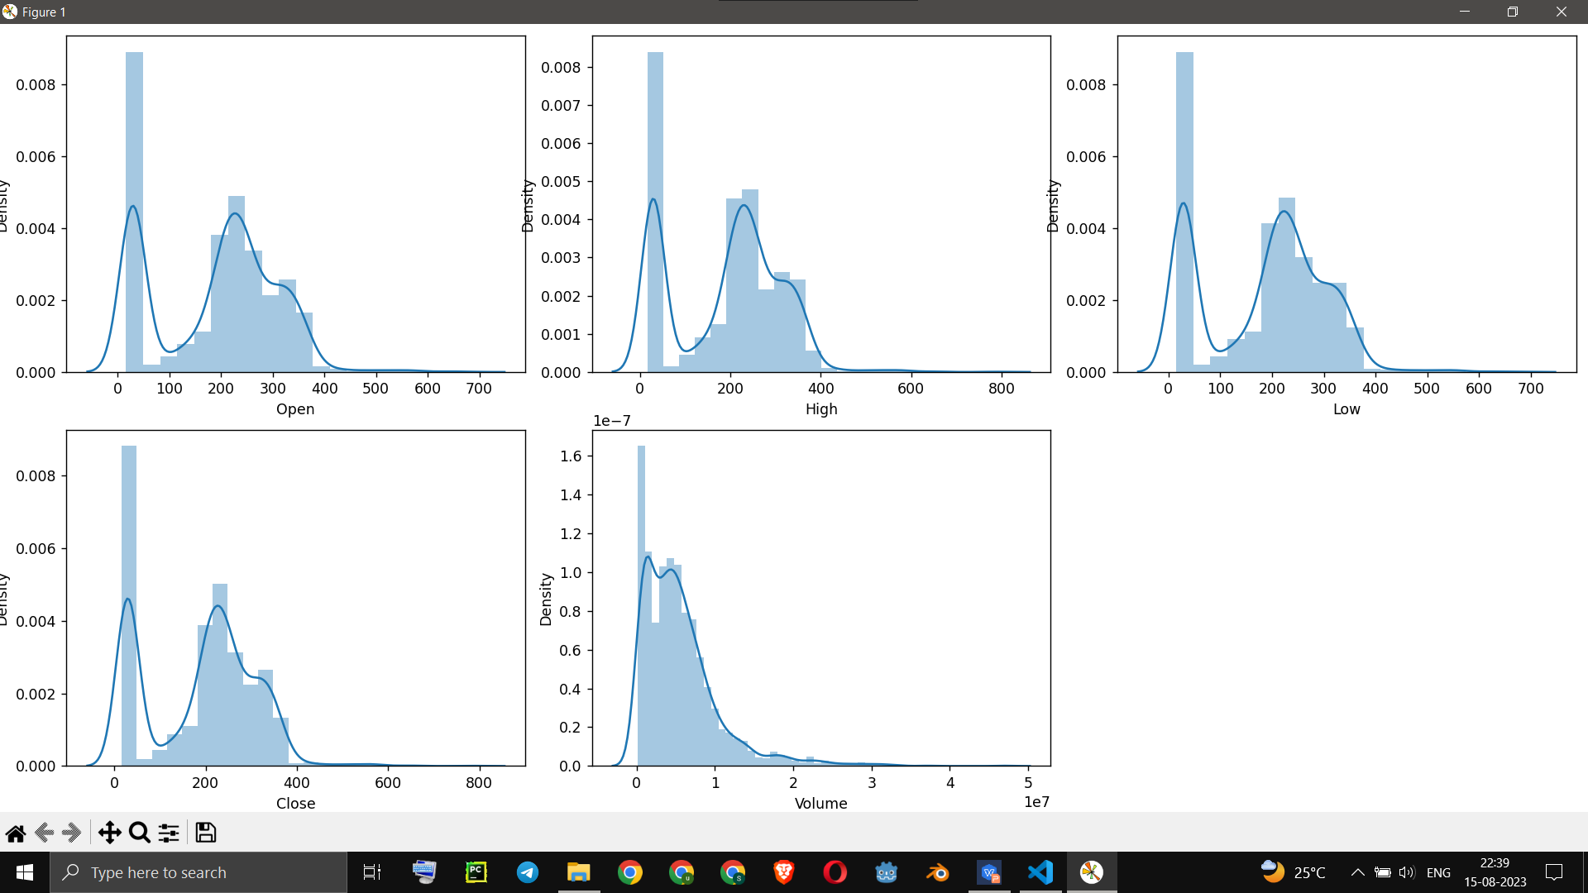
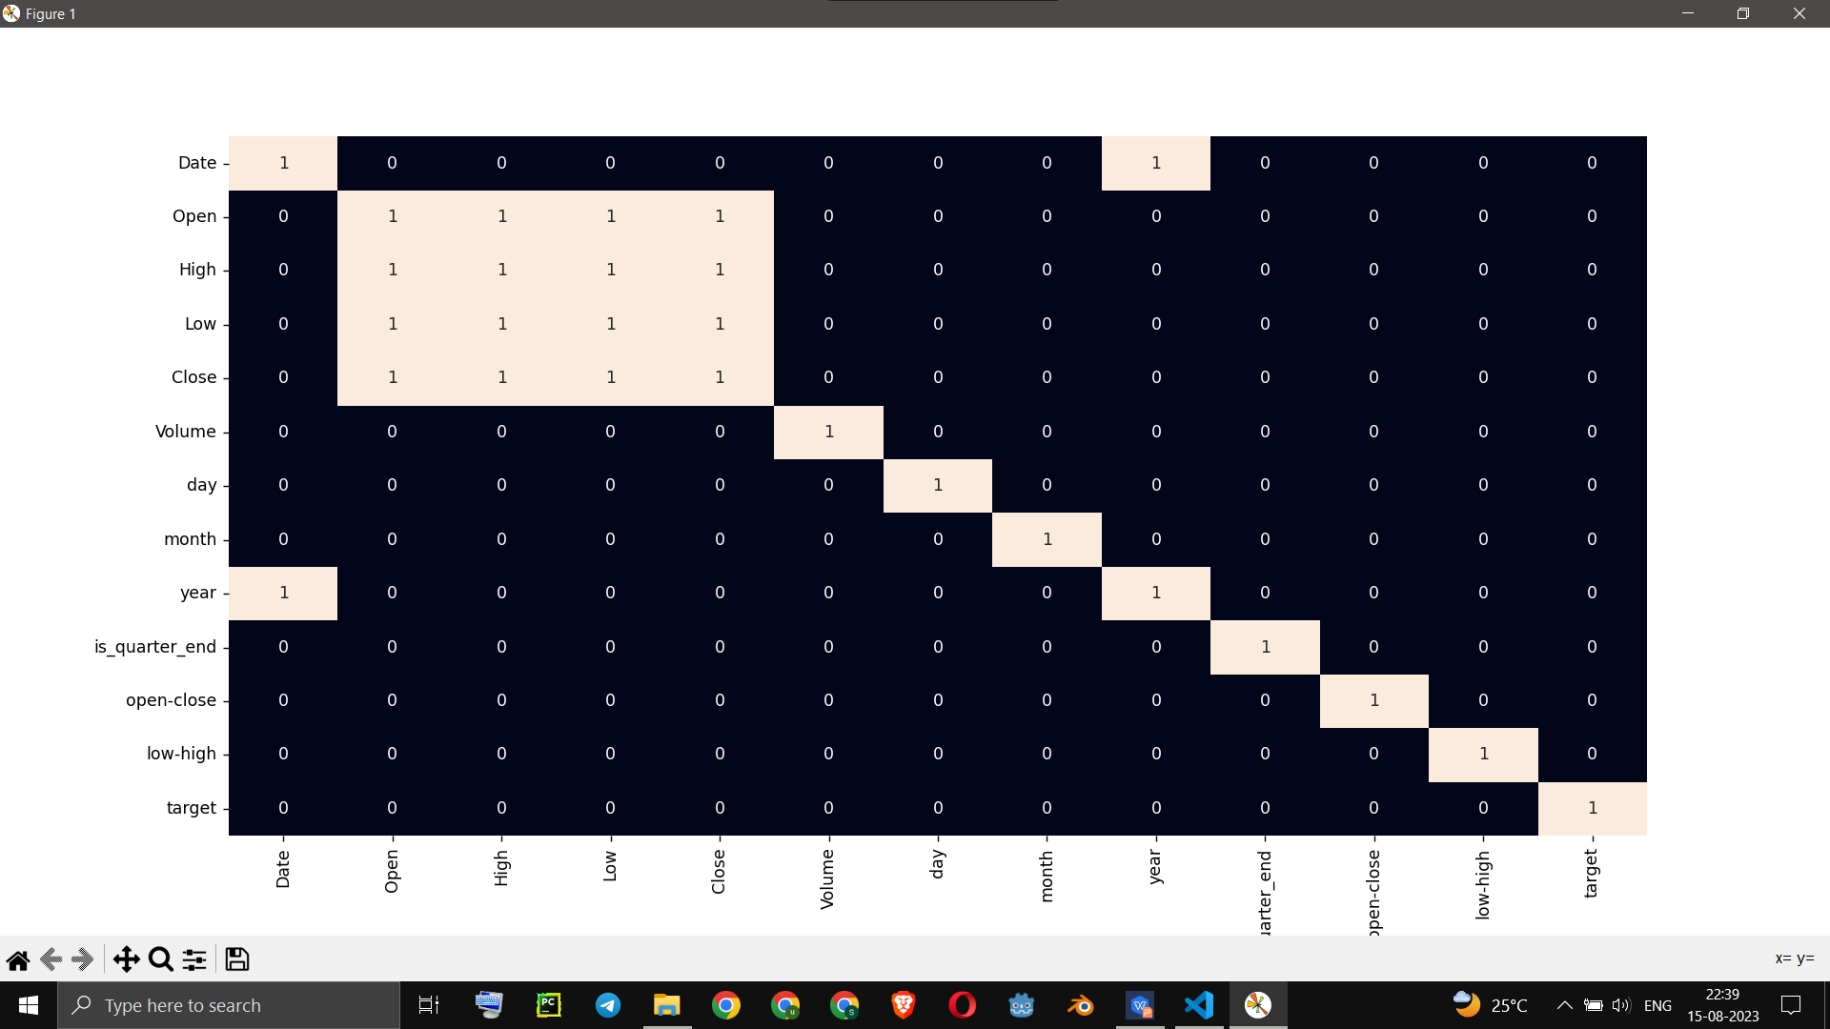
fig:2
fig:3

Slide 20
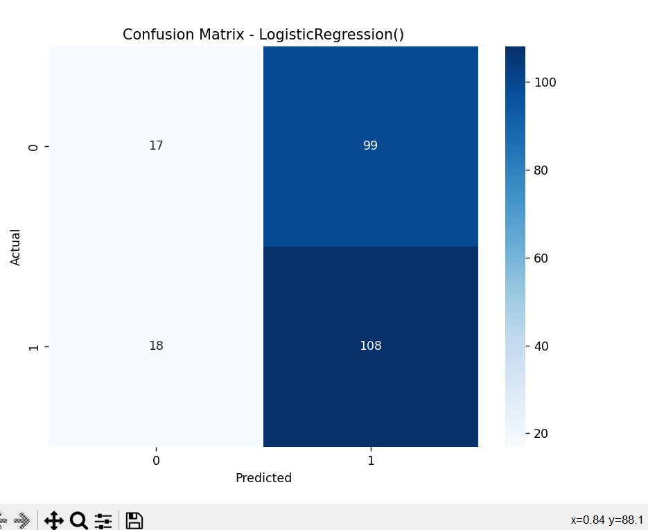
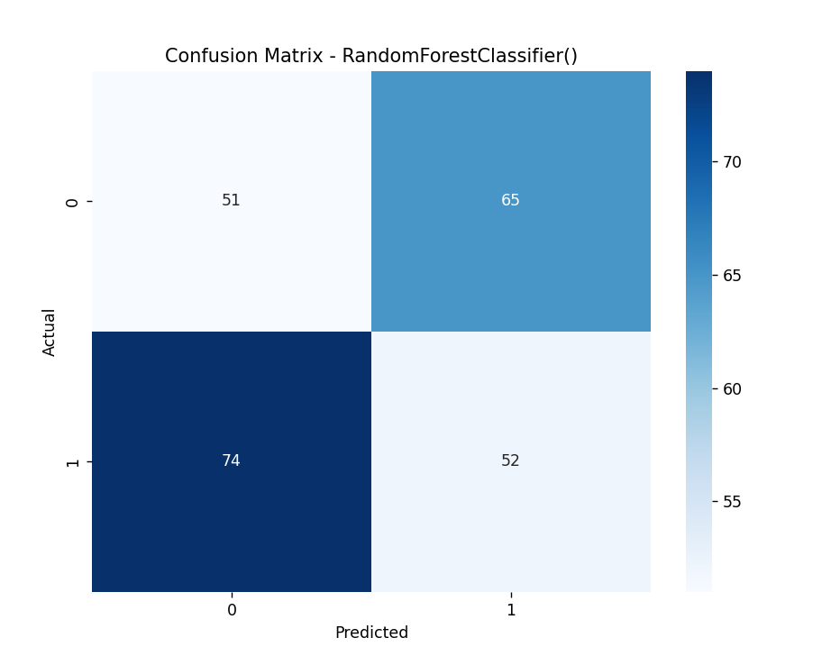
fig:4
fig:5

Slide 21
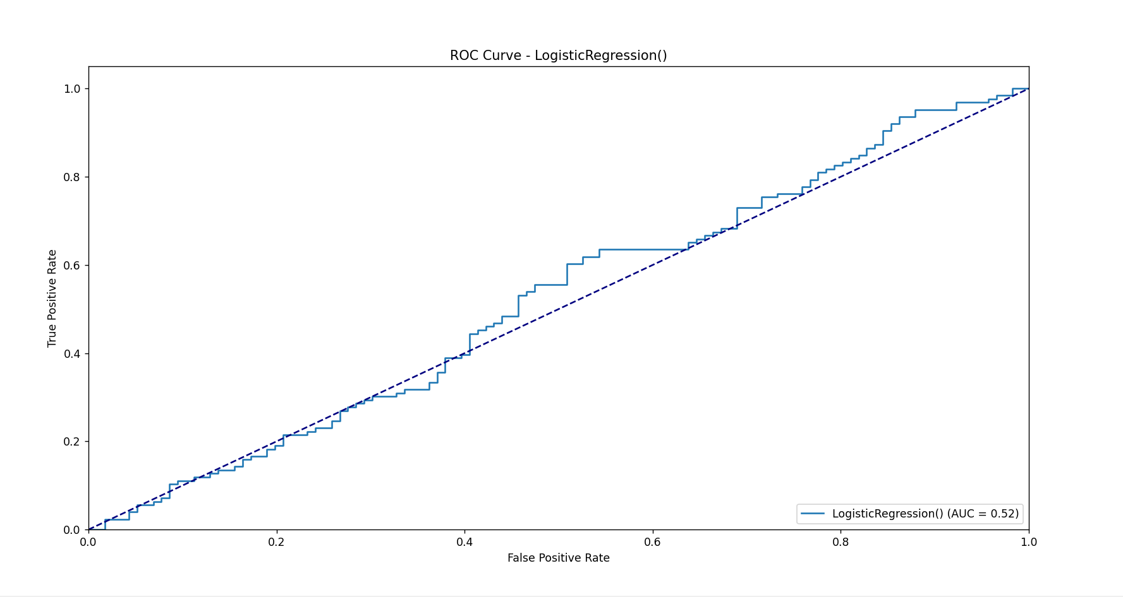

Slide 22
Conclusion
The "Tesla Stock Price Prediction using Machine Learning" project concludes with valuable insights into the world of stock market prediction and the practical application of data science and machine learning techniques. Through rigorous analysis, model development, and evaluation, the project sheds light on the possibilities and challenges of forecasting stock price movements.

Slide 23
Future work
In future work we can include
Ensemble Learning
Time-Series Analysis
Alternative Data Sources
Long-Term vs. Short-Term Predictions

